Slide 1
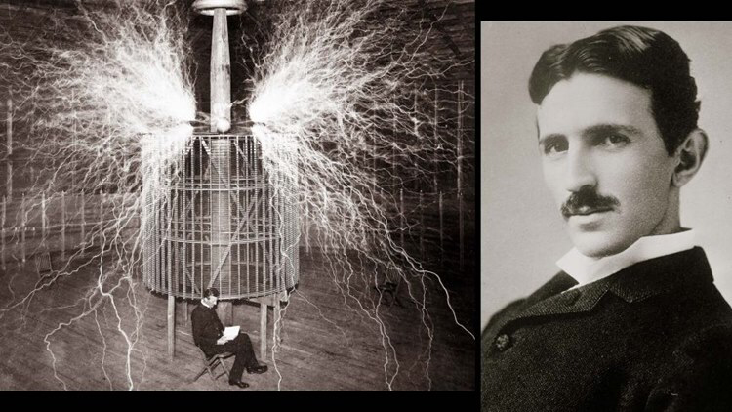
Guess the scientist
I was born in 1856
My inventions came as a result of visions
I claim to have nearly created an earthquake in Manhattan using electricity
My ultimate aim was to light up the earth’s atmosphere, eliminating darkness forever.
I obtained 300 patents in my lifetime, and pioneered work in x-rays, radio, electric light and wireless communication
I engaged in the ‘War of the Currents’ with my former employer Thomas Edison.
I fell in love with a pigeon

